Slide 1

Showcasing Grade 3
Arizona Studies
(prehistoric to Present Day)
Lesson Plans You Can Use Right Now!
Gale Ekiss and
Heather Moll
Co-Coordinator
Heather.Moll@asu.edu
https://geoalliance.asu.edu/

Slide 2
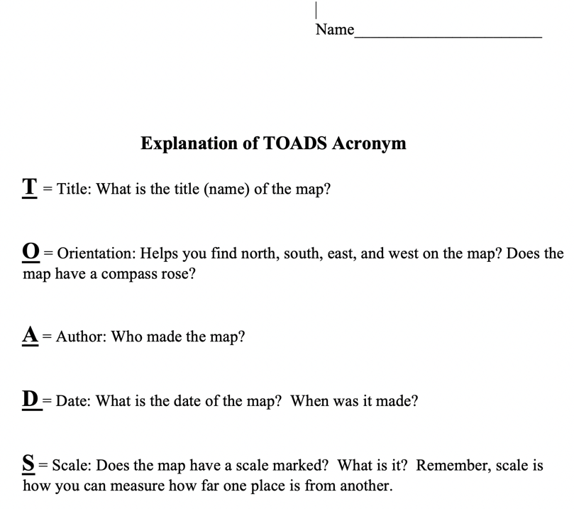

TOADS: An Introduction to Map Reading
By Gale Ekiss
Procedures:
Introduce the idea of an acronym.
Explain that TOADS are elements of a good map.
Teach TOADS.
Practice TOADS.

Slide 3
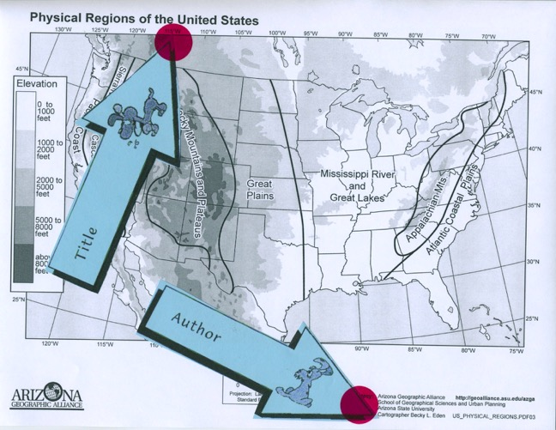
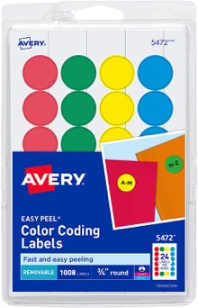

dogstails: An Introduction to Map Reading
By Gale Ekiss
Practice TOADS:
Divide students into pairs.
Each pair receives a map, set of TOADS labels, and 5 removable, sticky dots.
Partners work together to affix labels on the map with sticky dots.
Groups trade maps and keep practicing.
Assess when ready.

Slide 4
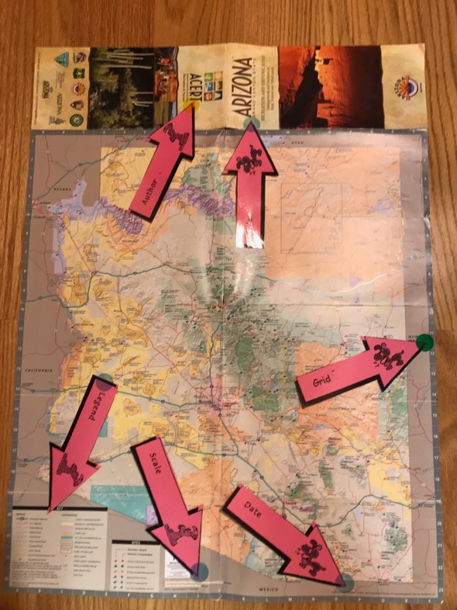


dogstails: An Introduction to Map Reading
By Gale Ekiss
Date
Orientation (compass rose)
Grid (B-3) or Lat/Long
Symbols ( )
Title
Author
Index (alphabetical listing with grid information to help locate places)
Legend (map key)
Scale (measurement device)

Slide 5
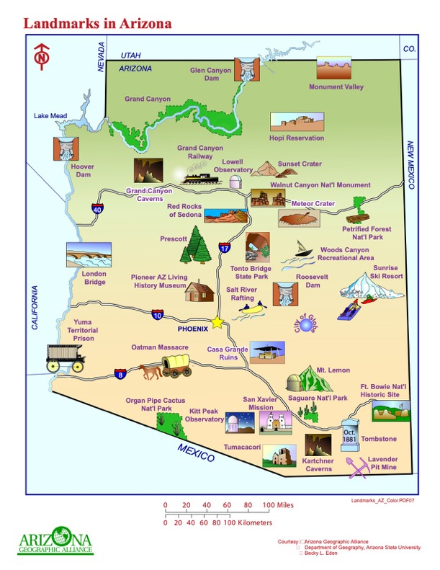
dogstails: An Introduction to Map Reading
By Gale Ekiss
Products completed during this lesson will require students to:
Evaluate the quality of maps.
Create maps of good quality.
Demonstration of Gale explaining the DOGSTAILS lesson: https://www.youtube.com/watch?v=gnbqi6HjyK4

Slide 6
dogstails: An Introduction to Map Reading
By Gale Ekiss
In the Chat Box, write whether you would use this lesson in your classroom.
Yes
No

Slide 7
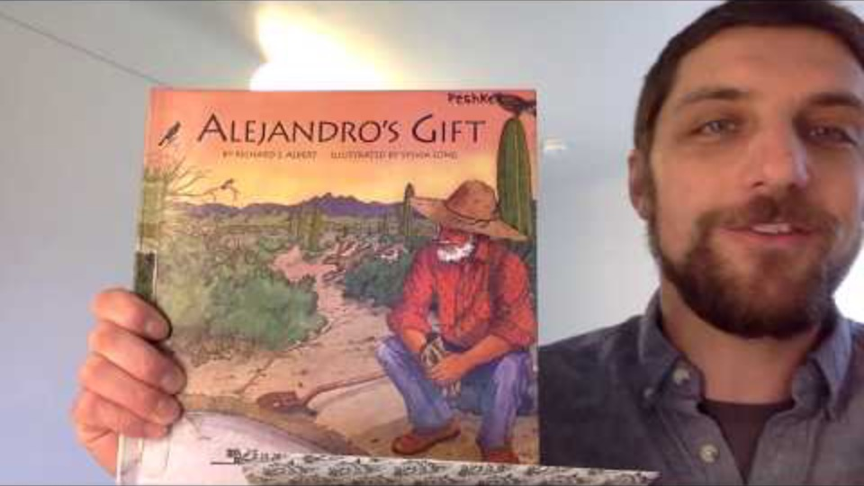
The Gift of Water: Modifying Our Environment
By Barbara Post
Procedures:
Introduce vocabulary: natural resources, adaptation, modification, and physical environment. (16 slides in PPT)
Read the book. https://www.youtube.com/watch?v=AMIU4lTMQLw
Discuss the book using the Teacher Question and Answer sheet.

Slide 8

The Gift of Water: Modifying Our Environment
By Barbara Post
Procedures:
Brainstorm facts about the desert and water sources based on the book.
Review the 5 Ws.
Who
What
Where
When
Why
How???

Slide 9
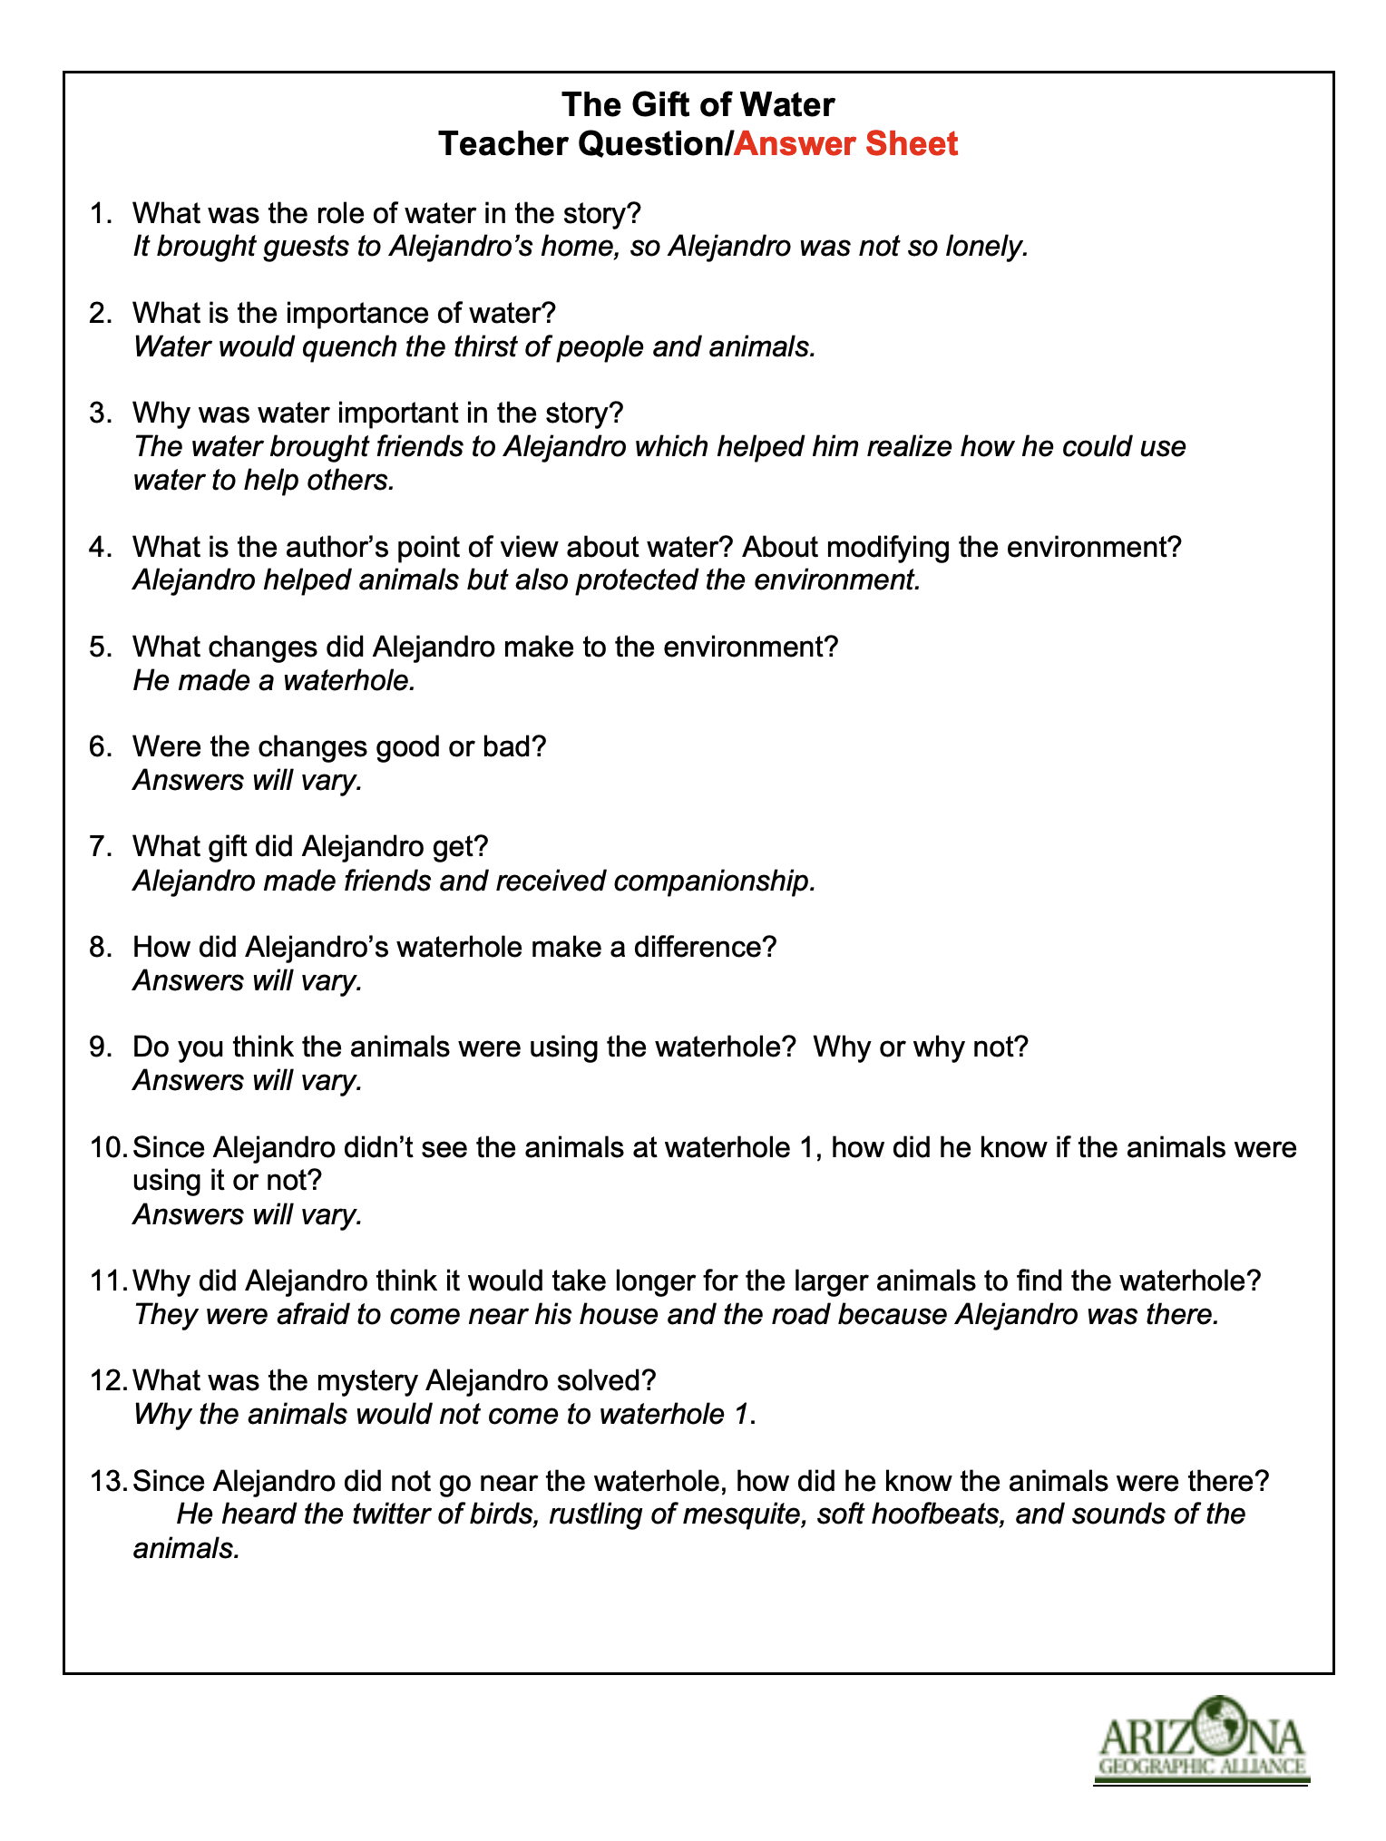
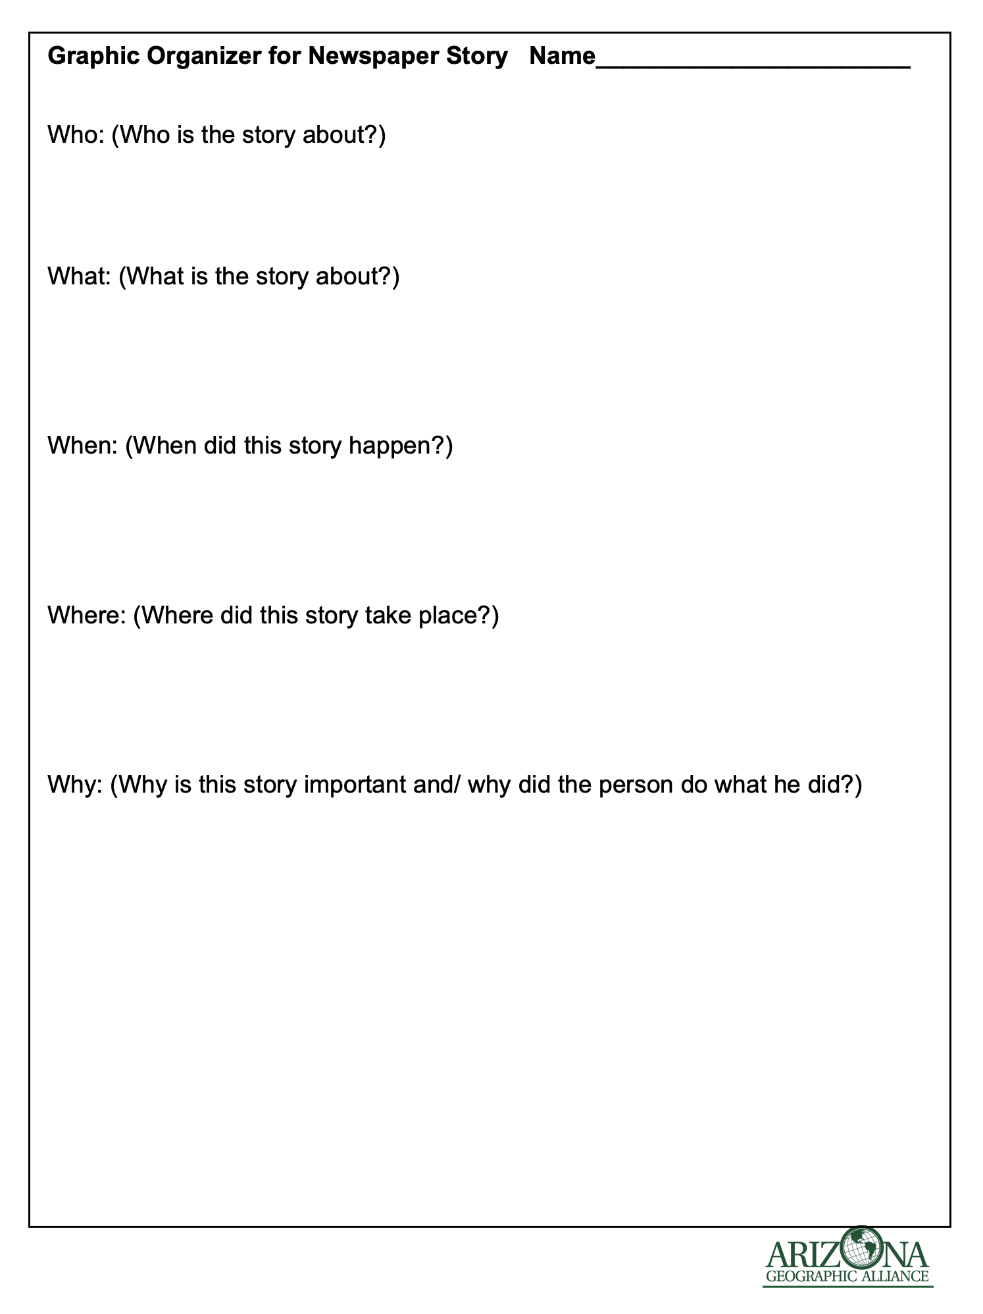
The Gift of Water: Modifying Our Environment
By Barbara Post

Slide 10
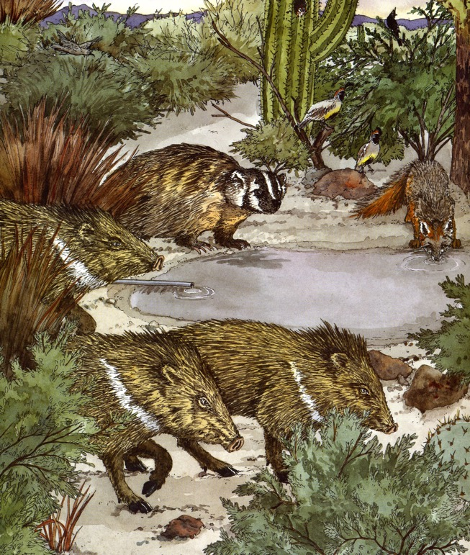
The Gift of Water: Modifying Our Environment
By Barbara Post
Procedures:
Have students write 3 sentences that are facts related to the desert, water in the desert, or inhabitants of the desert.
Have students write a story for the school newspaper reporting what Alejandro did to adapt to the desert and to modify the environment.

Slide 11


Environment:
Soil, climate, and living things that influence the the ability of a plant or animal to survive
https://e-csr.net/definitions/ecosystem-definition-example/

Slide 12

Words From Alejandro’s Gift
Cherish: To keep or care for with affection.
http://english.taipei.gov.tw/web/upload/112313820972800.jpg

Slide 13
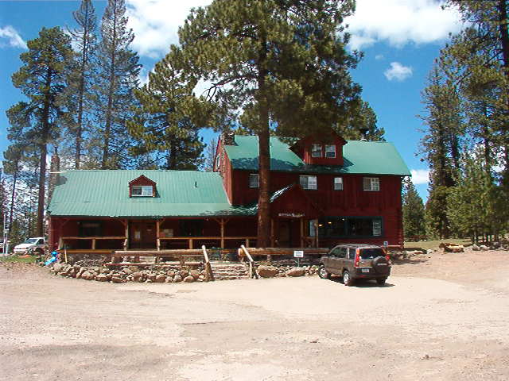
Modification:
A change that alters the environment
Photo by Gale Ekiss

Slide 14
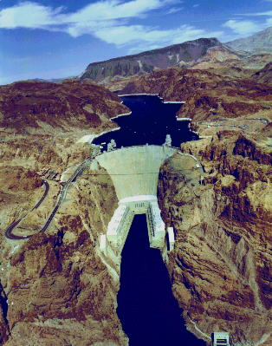
An Aerial View of Hoover Dam
What natural resource do you see in this photo?
What modifications were made to the physical environment?
geochange.er.usgs.gov

Slide 15
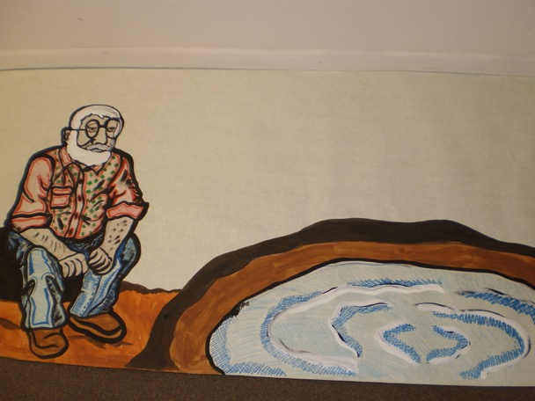
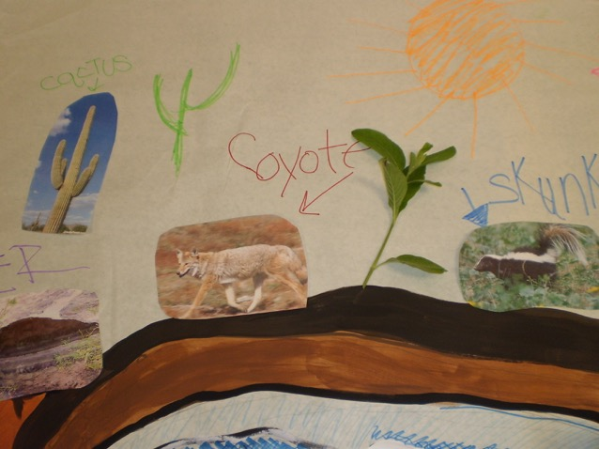
The Gift of Water: Modifying Our Environment
By Barbara Post
Enhanced Mural Idea
Base mural with background painting prior to student contributions.
Student contributions of pictures, artwork, labeling and plants.

Slide 16
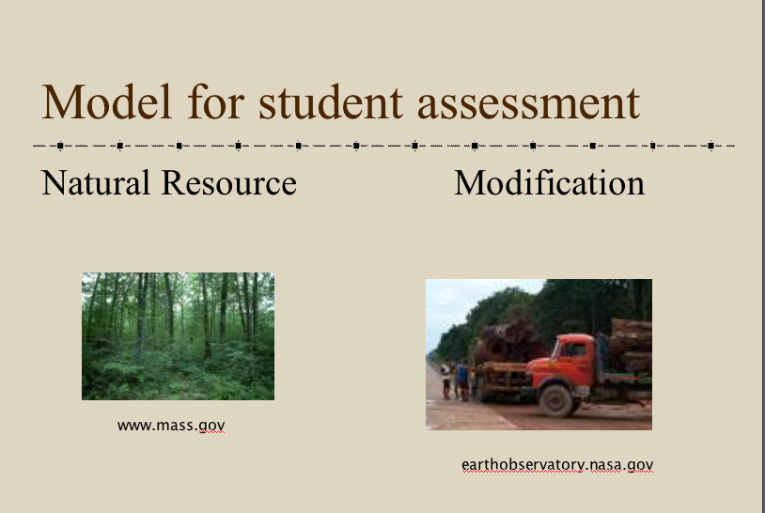
The Gift of Water: Modifying Our Environment
By Barbara Post
Products completed during this lesson will require students to:
Refer to details in a story.
Write informational text with a demonstration of good conventions of standard English.
Use new vocabulary.
Describe how humans modify the physical environment.
Slide 17 PPT: Students draw/write about one natural resource found in their community and then draw/write on how this resource is used or modified.

Slide 17
The Gift of Water: Modifying Our Environment
By Barbara Post
In the Chat Box, write whether you would use this lesson in your classroom.
Yes
No

Slide 18
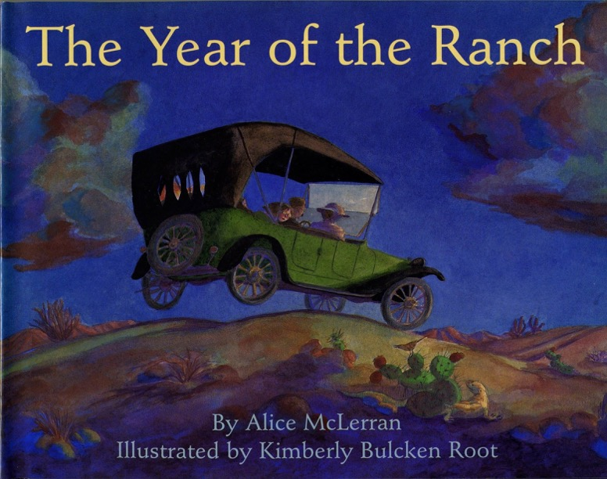
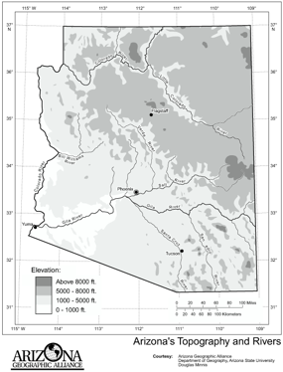
So that the Desert Can Blossom Like a Rose: Agriculture in the Desert
BY Carol Carney Warren
Procedures:
Locate Yuma and the Gila and Colorado Rivers on a map.
Read the book. (Amazon $3.00)
Use the Teacher Guided Question sheet to focus students on key information.

Slide 19
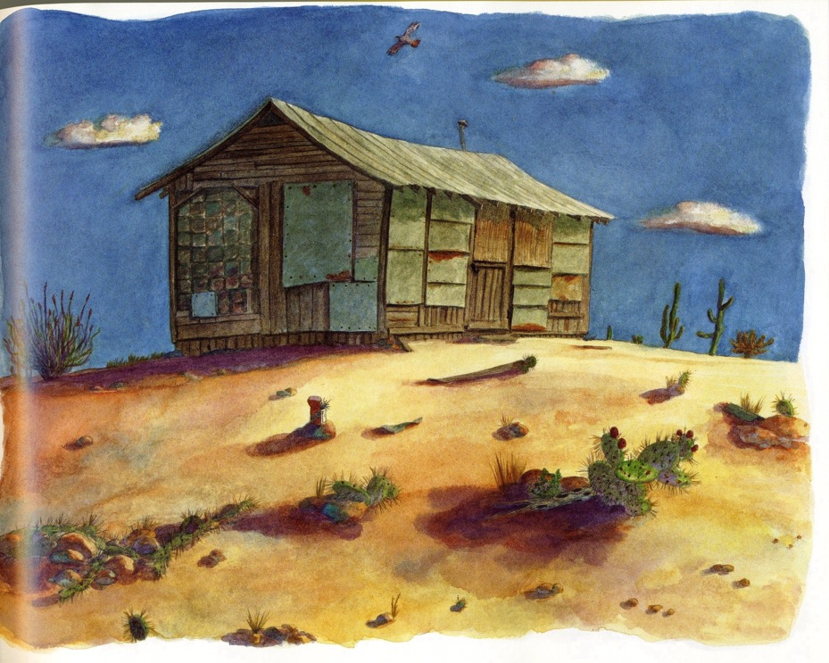
The Year of the Ranch
1919

Slide 20
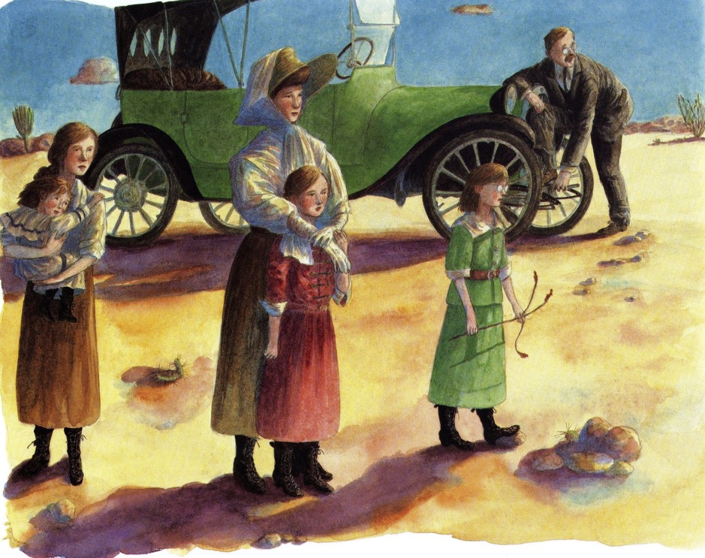
The Year of the Ranch

Slide 21
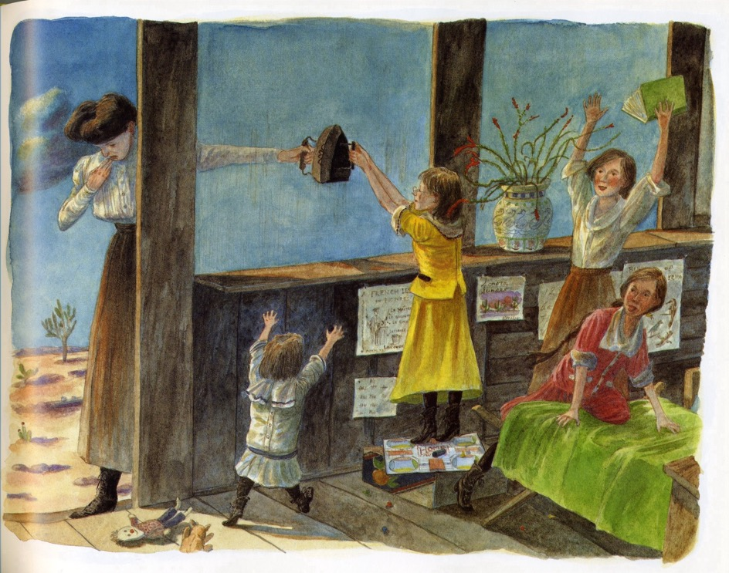
The Year of the Ranch

Slide 22
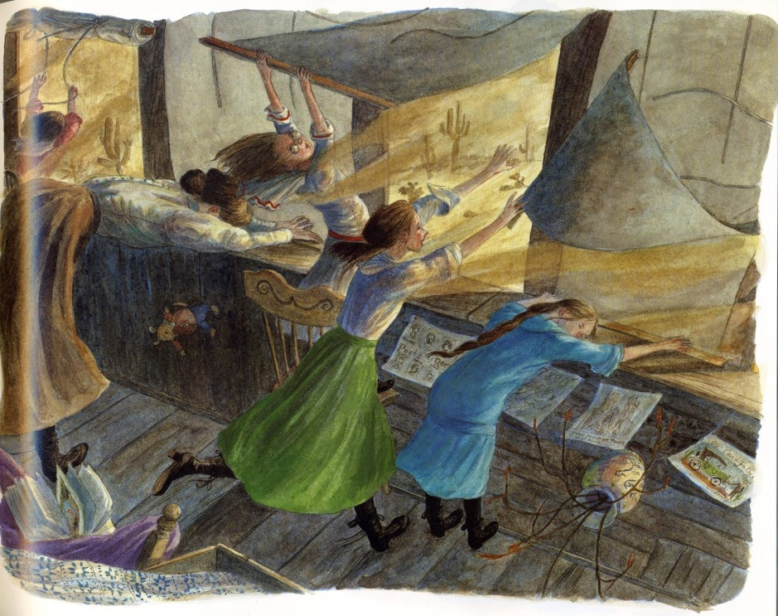
The Year of the Ranch

Slide 23
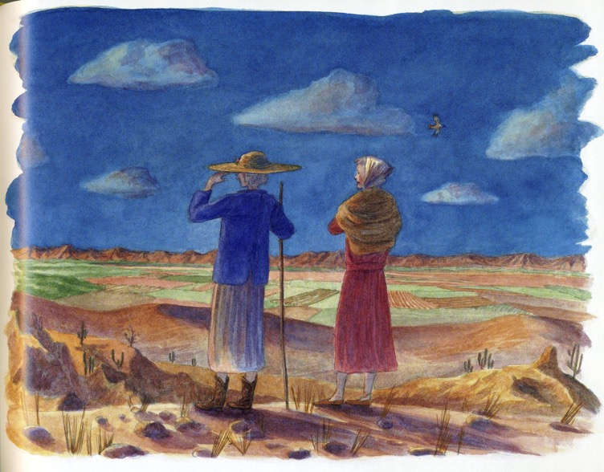
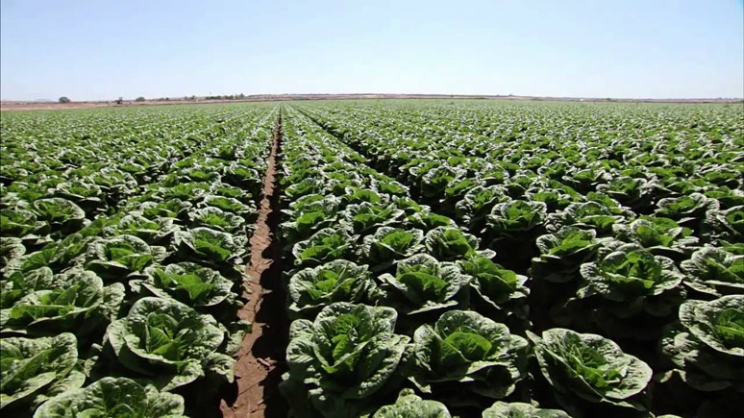
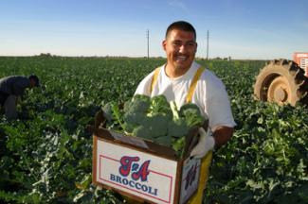
The Year of the Ranch
Now
Alfalfa, grass seed, cotton, dates, lemons, wheat
Melons, lettuce, broccoli, cauliflower, sugar squash,
Etc.

Slide 24
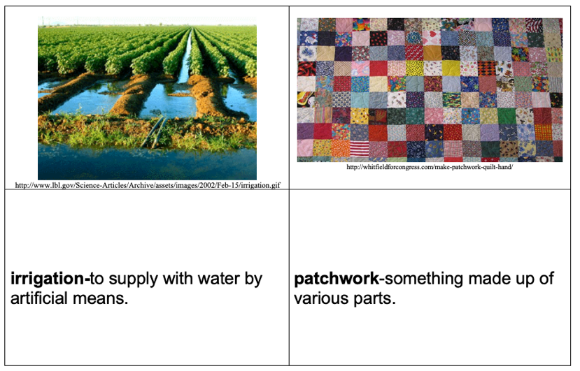
So that the Desert Can Blossom Like a Rose: Agriculture in the Desert
BY Carol Carney Warren
Products completed during this lesson will require students to:
Practice map skills.
Acquire new vocabulary. (homestead, migrate, irrigation, patchwork, shack)
Identify character traits.
Storyboard the events of the story.

Slide 25
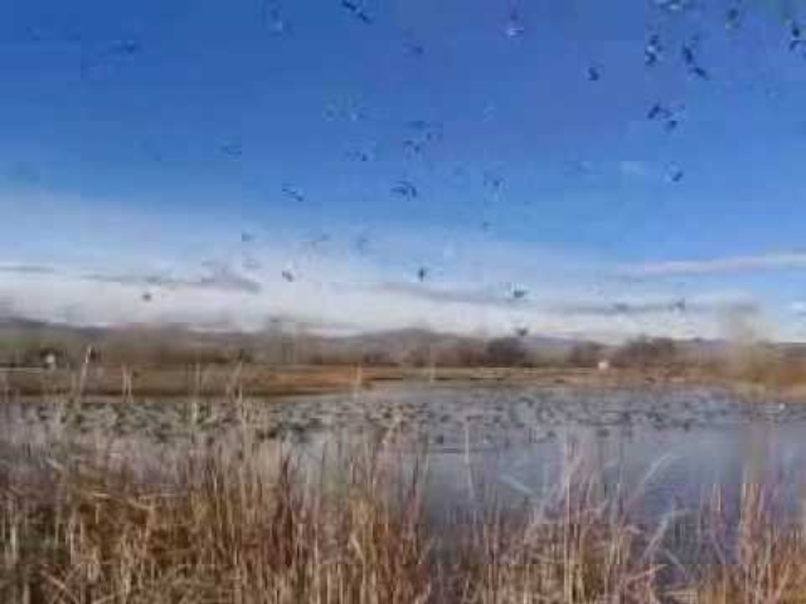
ELL Adaptation for So that the Desert….
Show video of migrating Canada geese.
https://www.youtube.com/watch?v=o-Yg_Nv4kvU

Slide 26






ELL Adaptation for So that the Desert….
Show photos of migration.
http://www.historyplace.com/unitedstates/lange/index.html

Slide 27
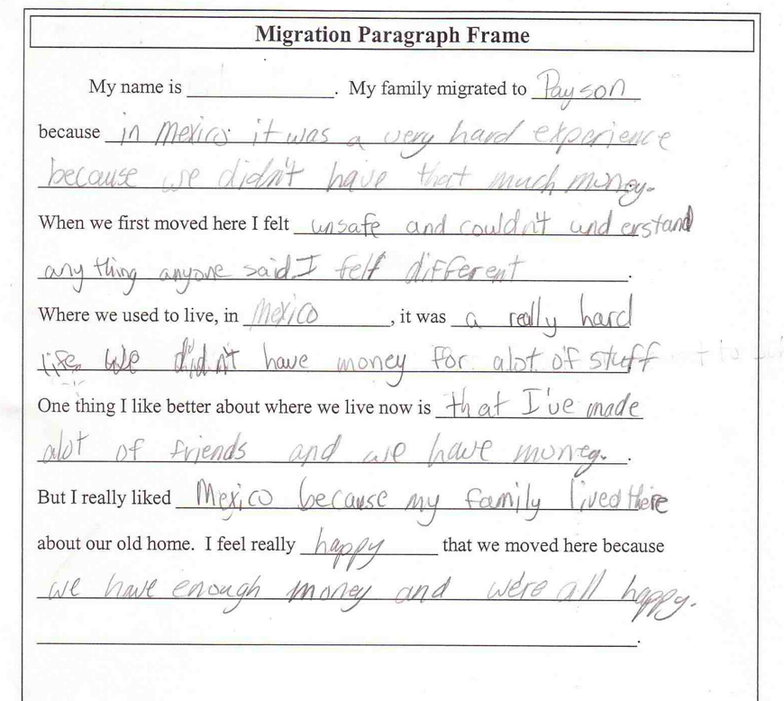
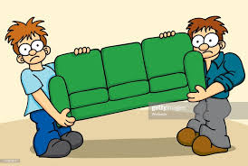
ELL Adaptation for So that the Desert Can Blossom….
Products completed during this lesson will require students to:
Apply the idea of migration to a move they have made.

Slide 28
So that the Desert Can Blossom Like a Rose: Agriculture in the Desert
BY Carol Carney Warren
In the Chat Box, write whether you would use this lesson in your classroom.
Yes
No

Slide 29
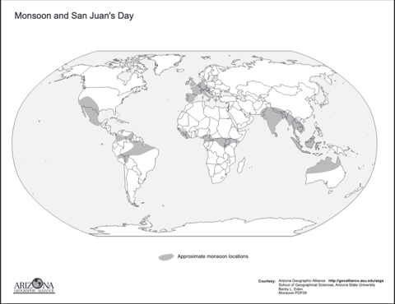
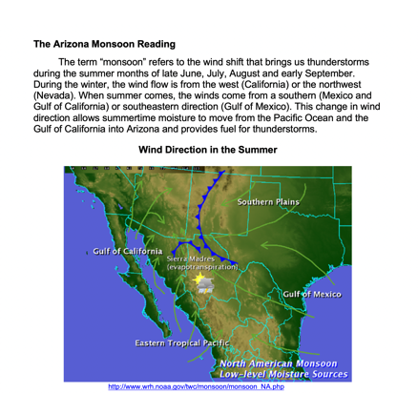
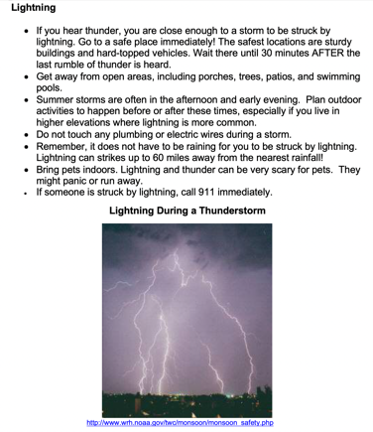
Monsoon Days
BY Gale Olp Ekiss
Procedures:
Label the continents where monsoon occurs.
Ask students for a definition of monsoon.
Read together about the monsoon and discuss the images in the reading.
Refine the definition of monsoon.
Have students read again the reading and color code words or phrases.
blue = winds brown = flash floods
red = lightning purple = dust storms

Slide 30

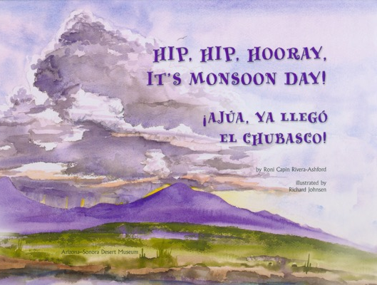
Monsoon Days
BY Gale Olp Ekiss
Procedures:
Read the book.
Interview with author: https://www.youtube.com/watch?v=7GD1omJTtDE

Slide 31
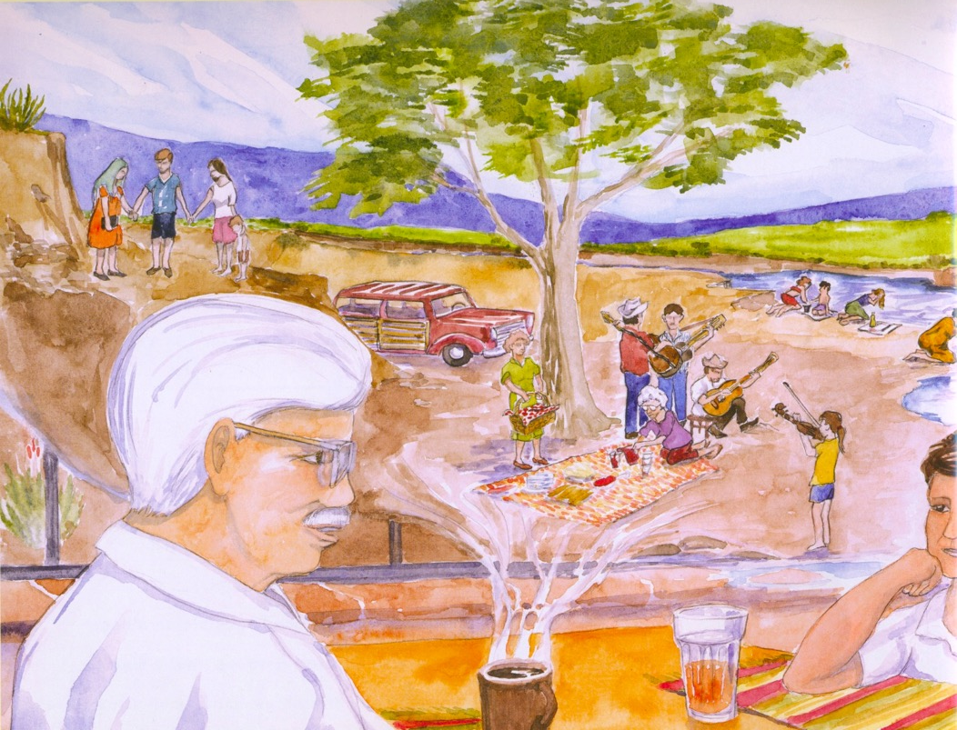

Slide 32
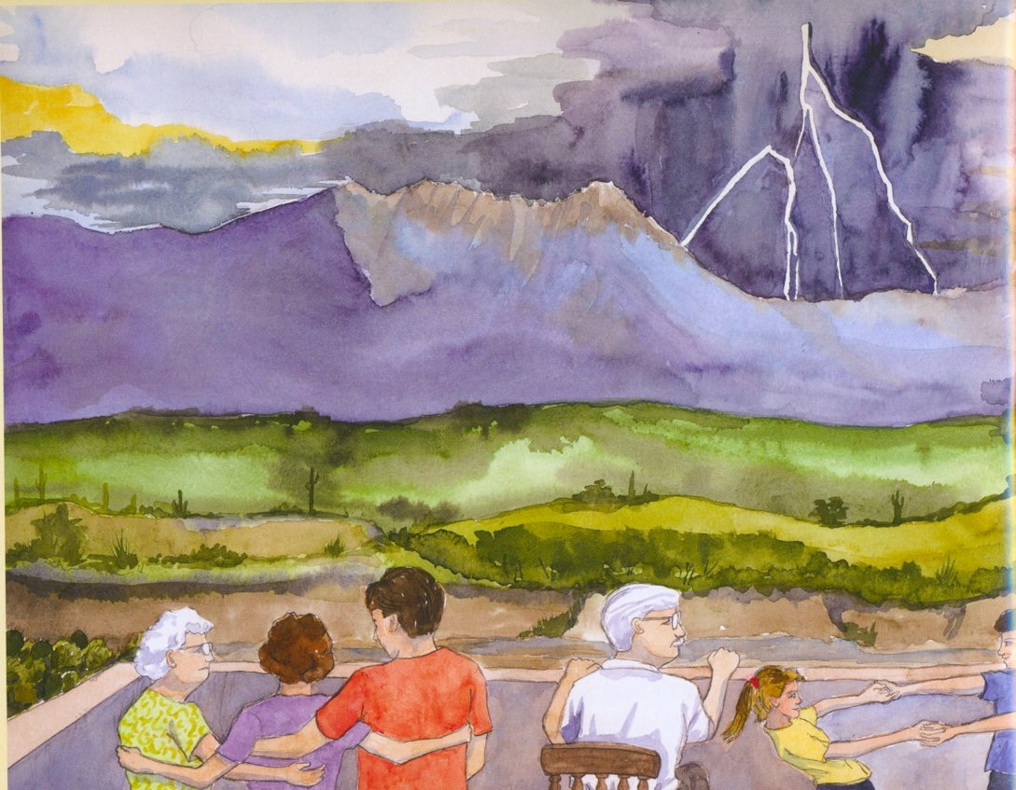

Slide 33
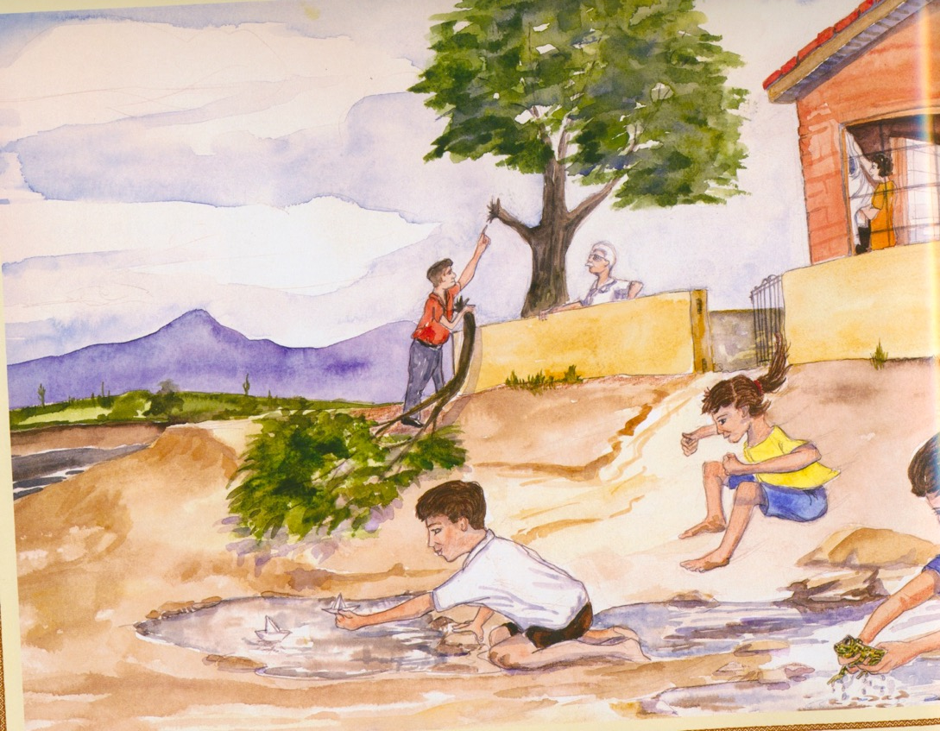

Slide 34
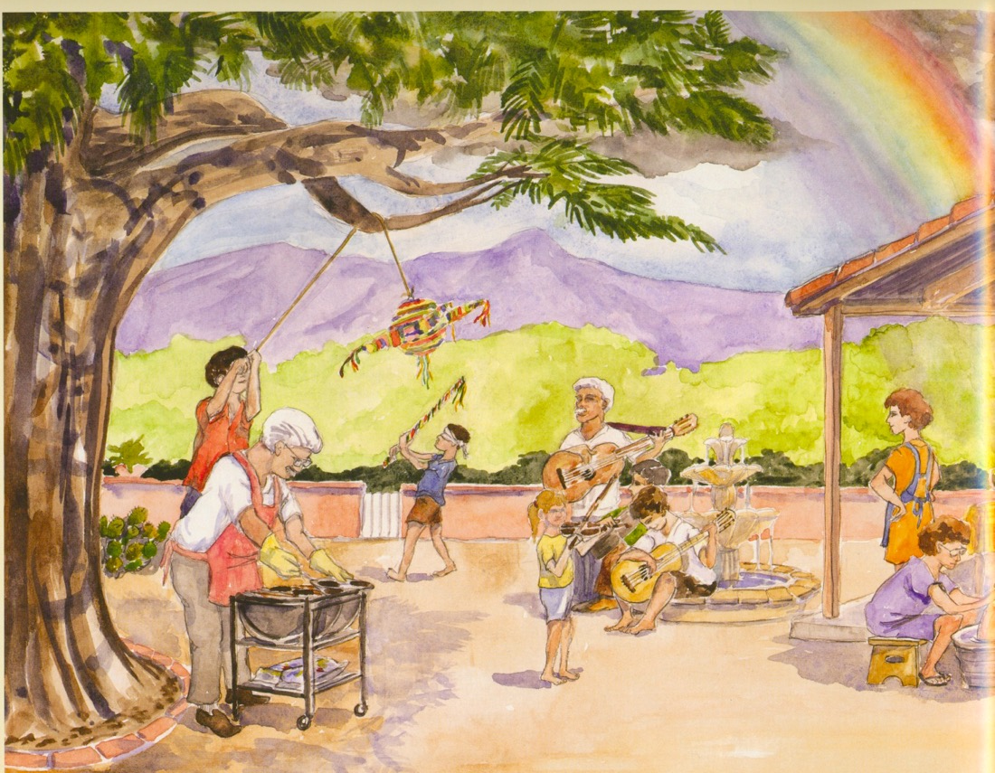

Slide 35
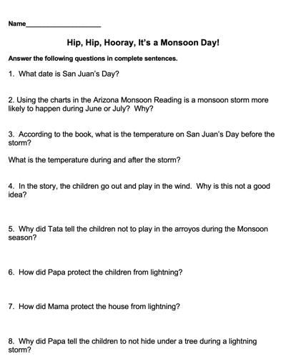
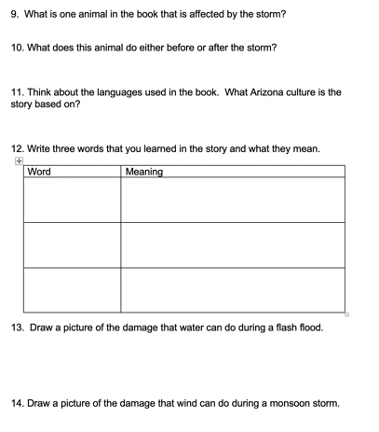
Monsoon Days
BY Gale Olp Ekiss
Procedures:
Complete a comprehension worksheet.
Color code the answers to the question.
blue = winds brown = flash floods
red = lightning purple = dust storms

Slide 36
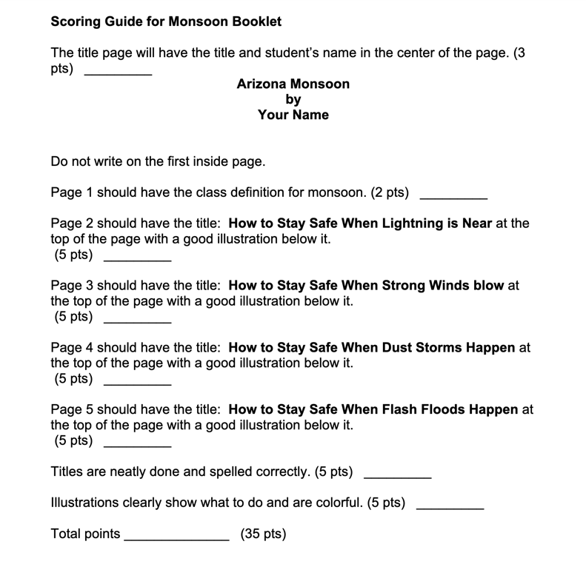
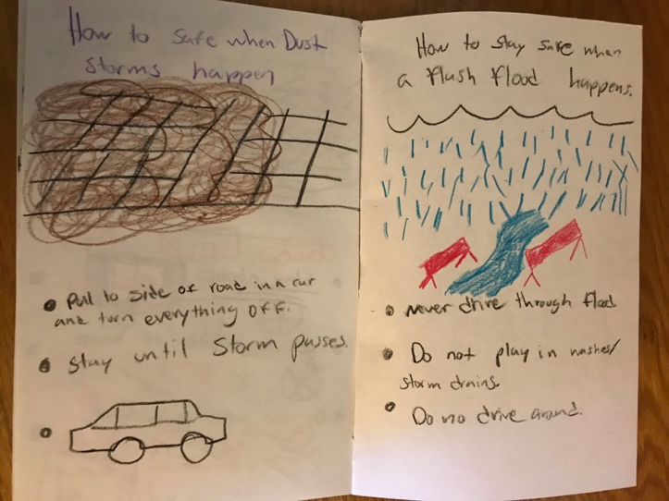
Monsoon Days
BY Gale Olp Ekiss
Product completed during this lesson will require students to:
Create a Monsoon Safety booklet.

Slide 37

Monsoon Days
BY Gale Olp Ekiss
In the Chat Box, write whether you would use this lesson in your classroom.
Yes
No

Slide 38
Dams that tamed Arizona’s rivers
By Lauren Tennyson
Procedures:
Discuss the definition of a desert: a land that receives less than 10 inches of rainfall per year (can be hot or cold).
Label and color the 3 regions of AZ: Mountain, Plateau, Desert.
Color rivers blue.

Slide 39
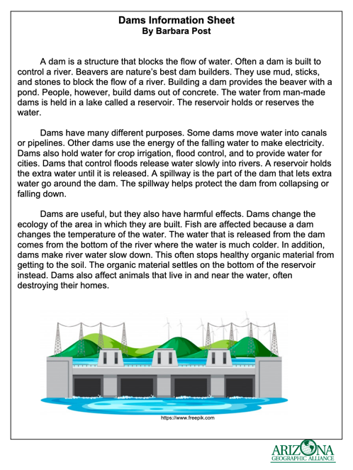
Dams that tamed Arizona’s rivers
By Lauren Tennyson
Procedures:
Discuss the definition of a flood and why flooding is not good.
Read Dam Information Sheet.
Discuss Important Dams in AZ map.

Slide 40
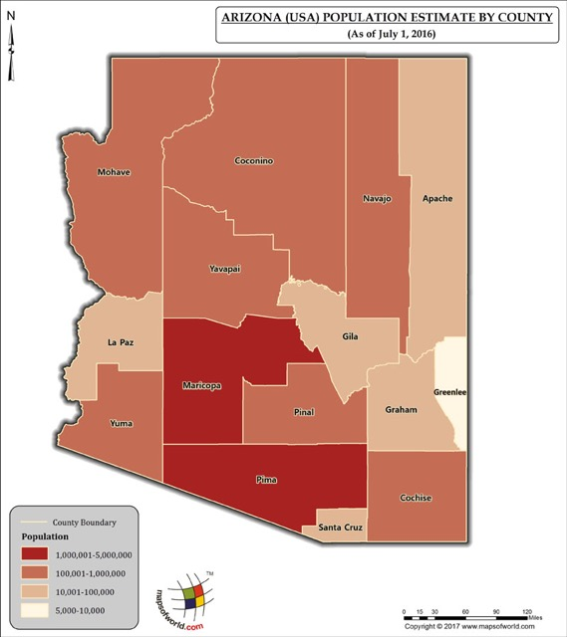
Dams that tamed Arizona’s rivers
By Lauren Tennyson
Products completed during this lesson will require students to:
Use multiple maps to gain information.
Compare where people live in AZ to where rivers are found.
Reflect upon how our environment impacts our lives.

Slide 41
Dams that tamed Arizona’s rivers
By Lauren Tennyson
In the Chat Box, write whether you would use this lesson in your classroom.
Yes
No

Slide 42
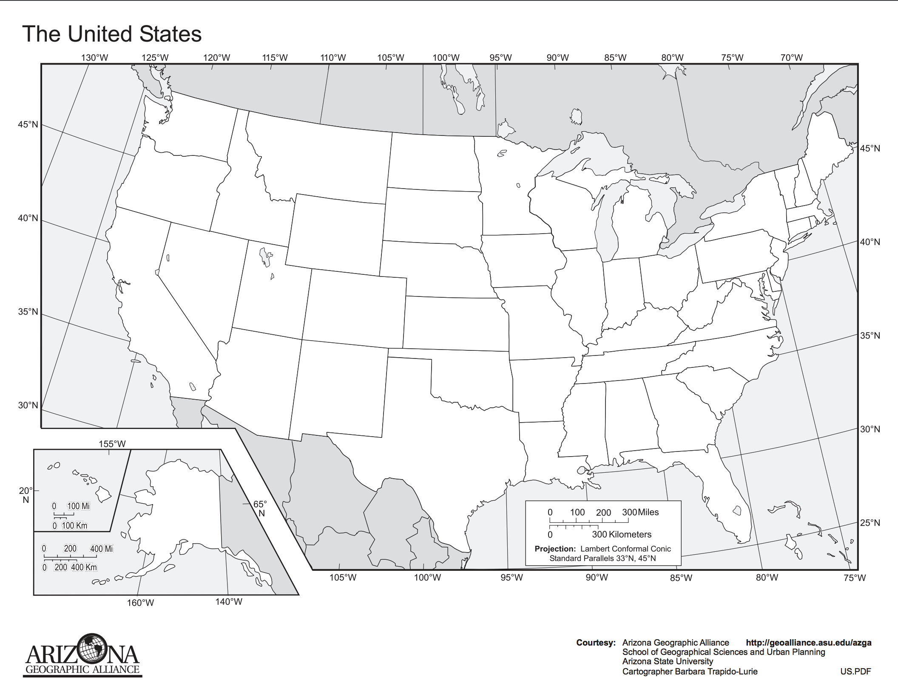
Levels of Government: Identifying the Different Levels of Our Government
BY Heather Moll
Procedures:
SESSION ONE
Begin the lesson by asking students if they know who is in charge of the following: • police (usually the city) • fire department (usually the city) • freeways (usually the state or national government) • U.S. Army (national) • schools (usually the city)
Have a discussion with the class about what they think are the different levels. Then write the terms: city government, state government, and national government on the board.
Distribute the U.S. map. Have students find their state and write in its name. Then have them find their city and write in its name. Then have them circle the last level of government in the title (United States). Explain that today they are going to learn about these three levels of government and their duties.
City Government
State Government
National Government

Slide 43
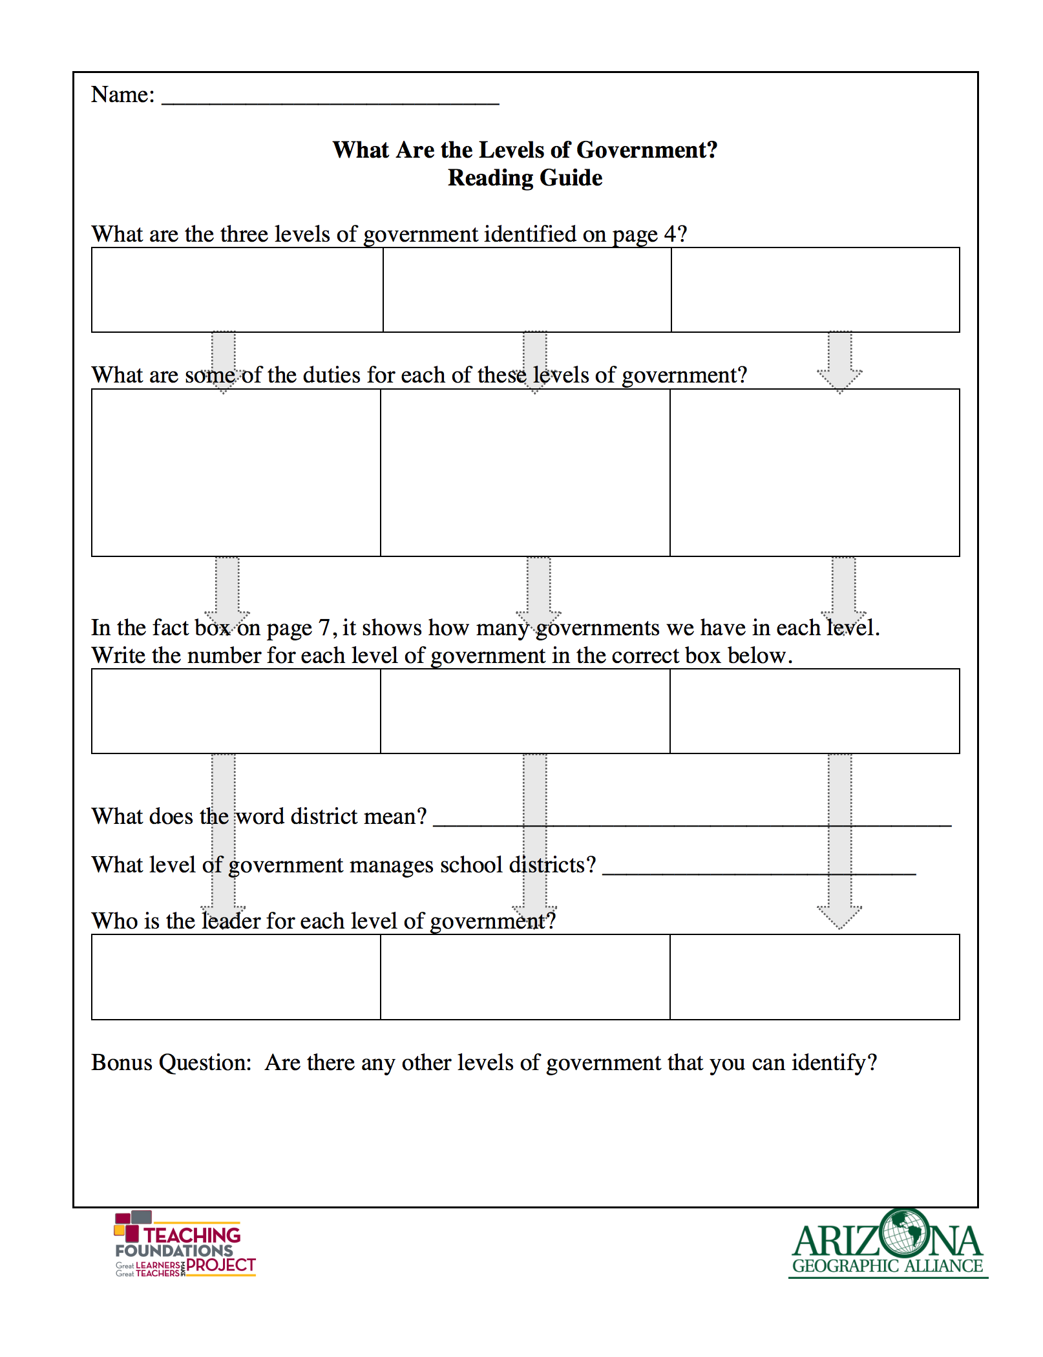
Levels of Government: Identifying the Different Levels of Our Government
BY Heather Moll
SESSION ONE
Distribute and project the What Are The Levels Of Government? Reading Guide.
Introduce the book What Are the Levels of Government? People, Power, and Process by Baron Bedesky.
Have the students turn in the reading guide and U.S. map as assessments for the day.
End class by having students share with a neighbor two things they learned today.

Slide 44


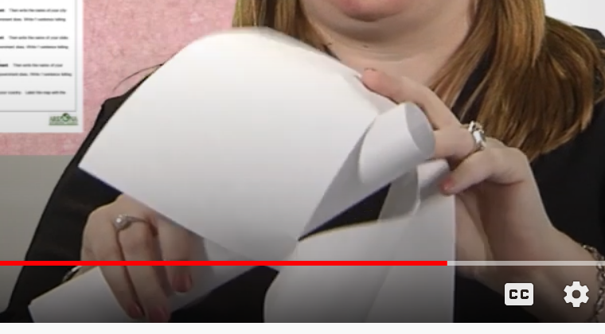
Levels of Government: Identifying the Different Levels of Our Government
BY Heather Moll
SESSION TWO
Note: Teacher (or classroom volunteer) will need to create the burrito books ahead of time or allow extra time for students to create the booklets.
9. Begin day two by passing back their reading guide from the day before, review what they learned.
10. Distribute burrito books already assembled and explain what is required on each page or distribute burrito book directions and 2 sheets of 8 1/2’’ x 11’’ blank paper to each student. As a class create the burrito books, once completed explain to the students what is required on each page.
11. Share the Scoring Guide for Burrito Book and a model of a completed book.
12. Hand back yesterday’s United States map for students to use as a reference when drawing page 8 of the book.
13. Have students turn in their burrito books when finished.

Slide 45
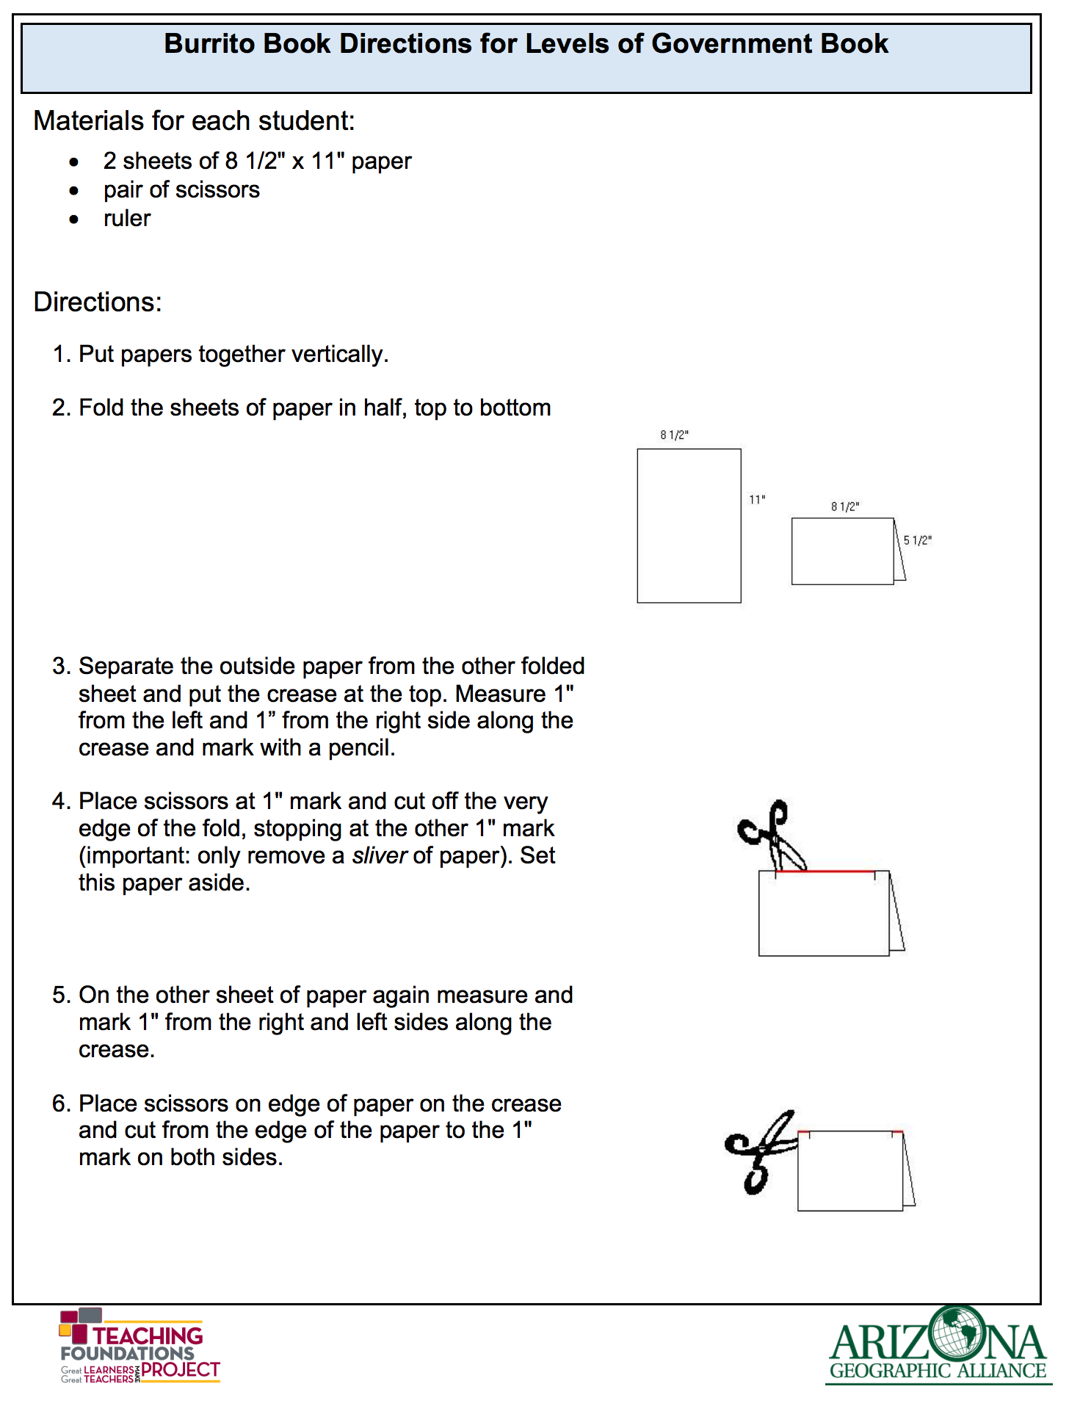
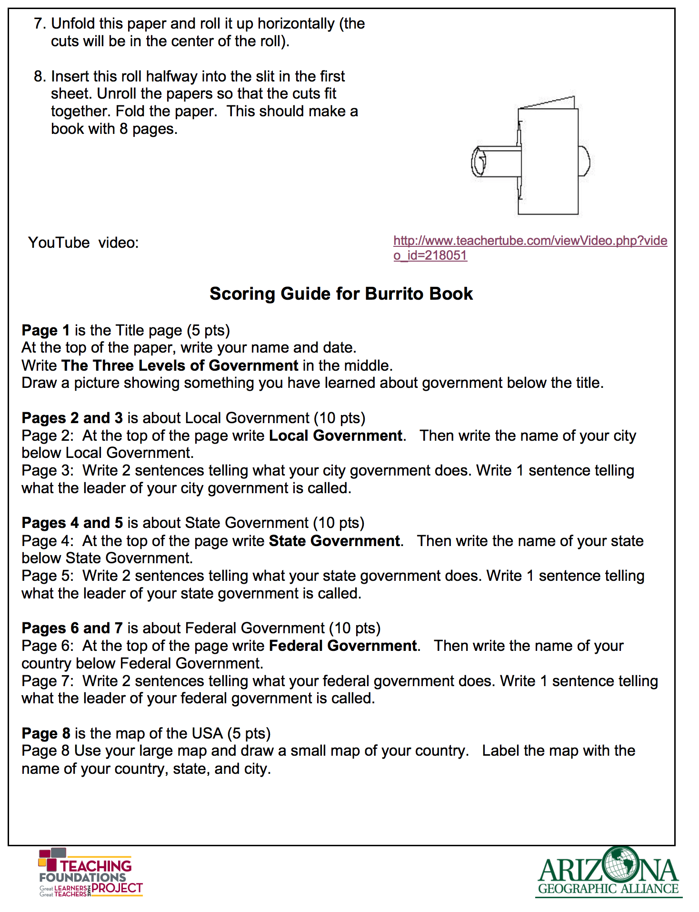
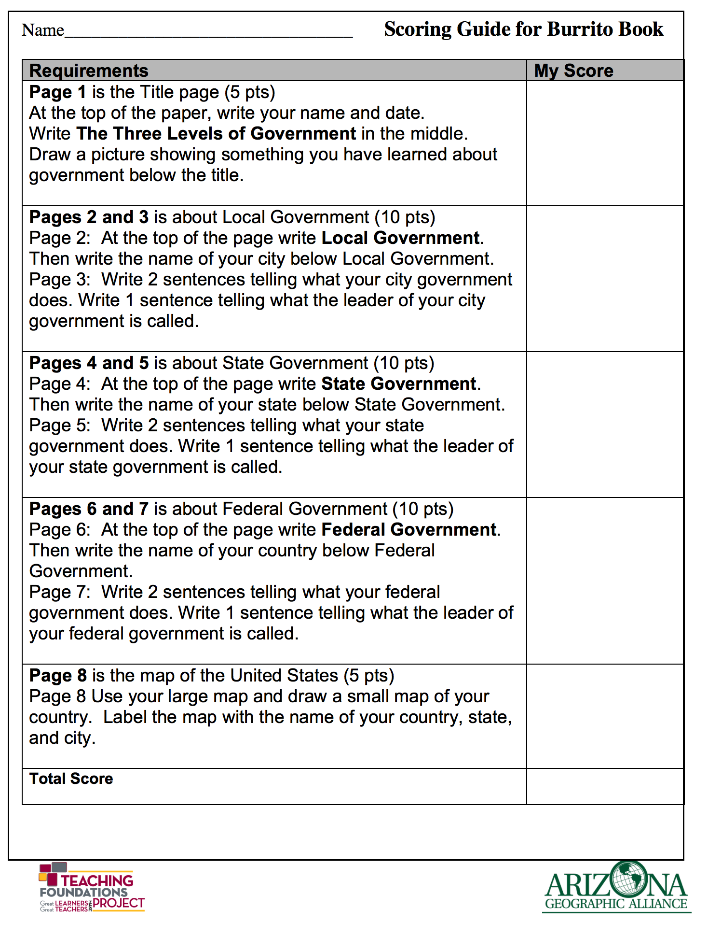
Levels of Government: Identifying the Different Levels of Our Government
BY Heather Moll

Slide 46

Levels of Government: Identifying the Different Levels of Our Government
BY Heather Moll
Products will require students to:
Locate and Label a US Maps
Complete a Burrito Book summarizing what they read in the book.
Answer questions on a reading guide.
This Photo by Unknown Author is licensed under CC BY-SA

Slide 47
Levels of Government: Identifying the Different Levels of Our Government
BY Heather Moll
In the Chat Box, write whether you would use this lesson in your classroom.
Yes
No

Slide 48
Arizona: way out west and witty
BY Gale Olp Ekiss
Lesson Note: This lesson is designed for 10 sessions. However you can pick and choose which parts you would like to do. Stretch it out over 10 weeks, 10 months, whatever works for your classroom.
Overview: Students living in Arizona should know some of the distinct characteristics of this place and be able to express to others the uniqueness of our state in terms of human and physical characteristics.
Purpose: In this lesson, students will read the book Arizona: Way Out West and Witty, select a community and create an Arizona Atlas highlighting human and physical features of that community.

Slide 49
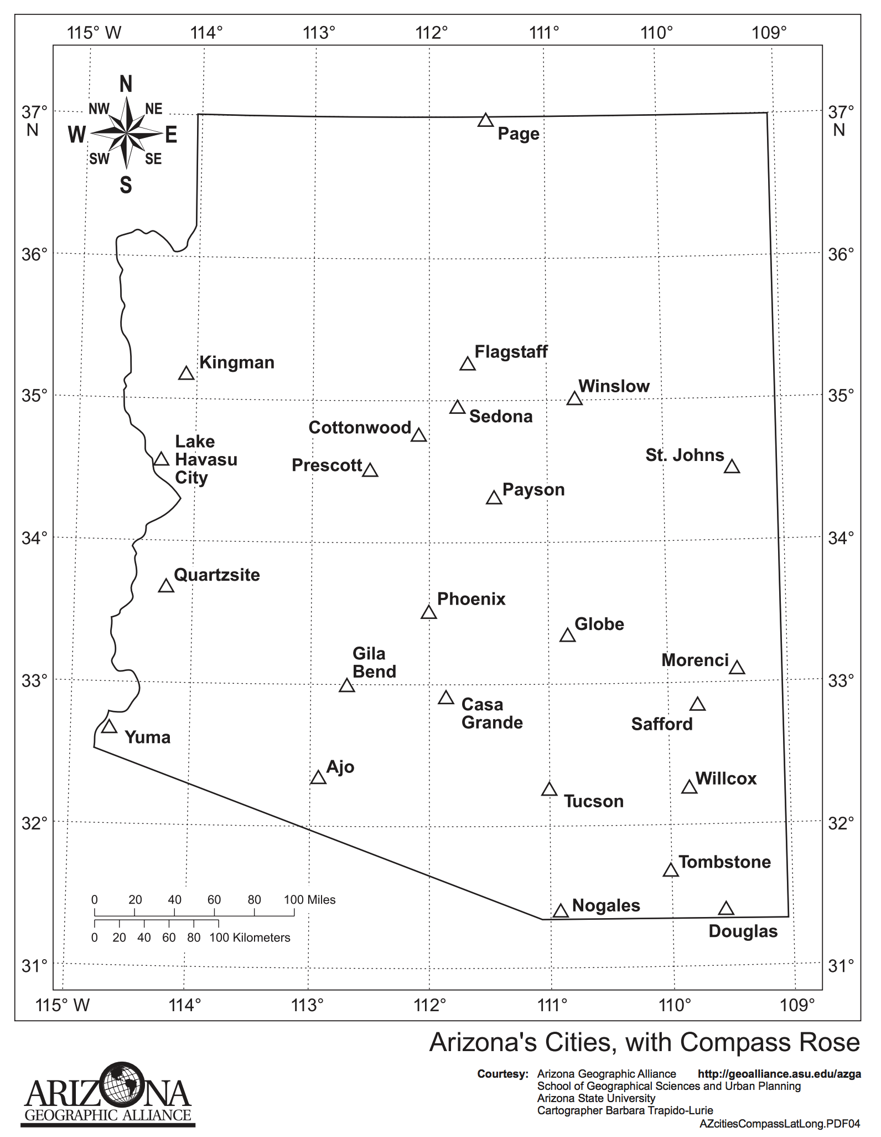
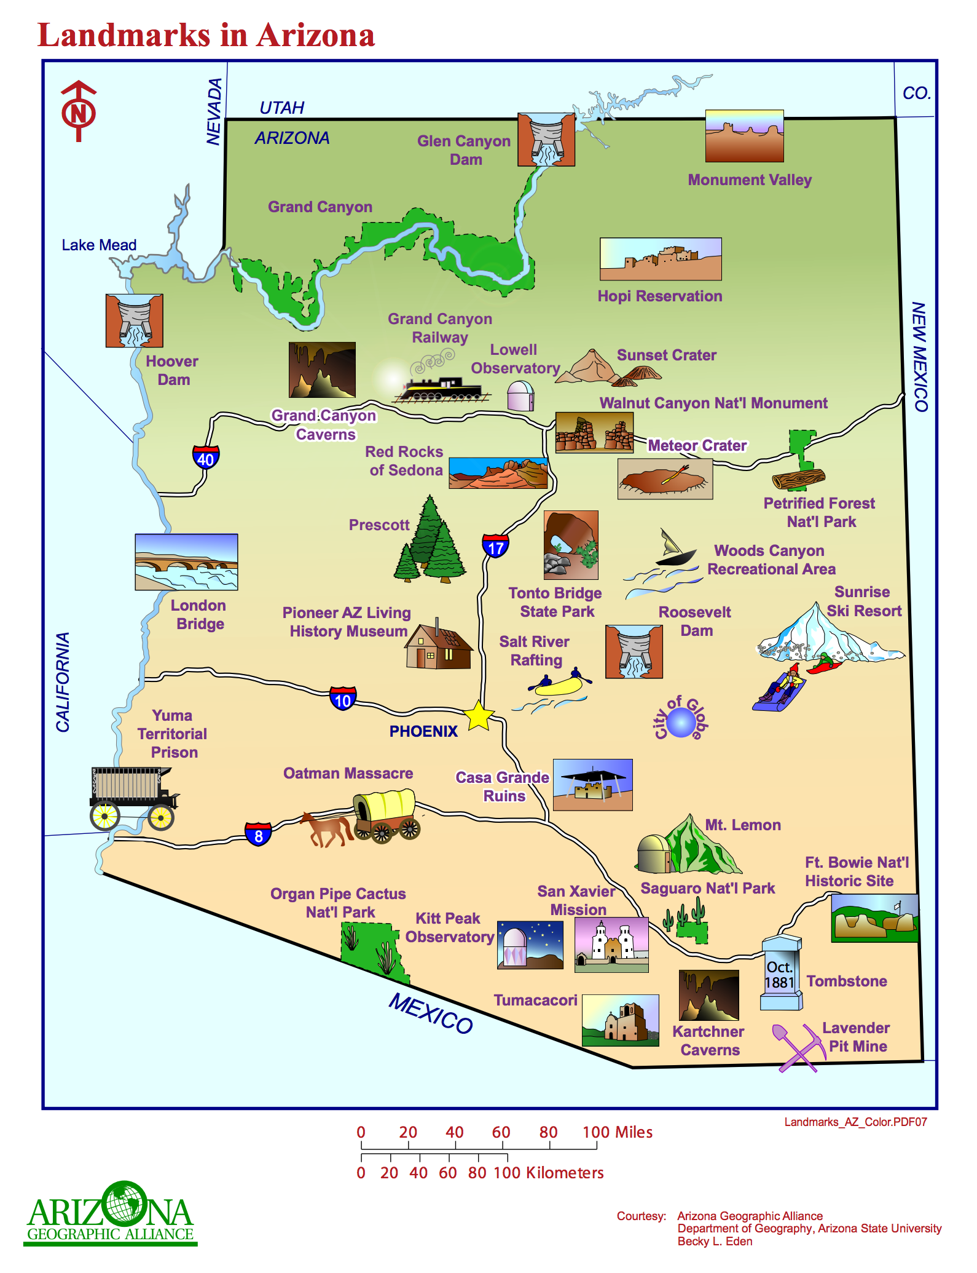
Arizona: way out west and witty
BY Gale Olp Ekiss
SESSION ONE
Anticipatory Set: Have students look at the 2 maps of Arizona (Landmarks in Arizona Map and Arizona Cities, with Latitude and Longitude Map).
    Ask a few students to comment on places they have visited that are listed on the map.
    Review the definitions of a human and physical feature. (Human features are those things created by man—dams, monuments, mines, etc. Physical features are created by nature: rivers, mountains, deserts, etc.)
    Now have the students look for human features on the Landmarks map and then physical features. For example for Sunrise Ski Resort, the resort is manmade as well as the human enjoying the snow. However, the mountain and the snow are physical features.

Slide 50
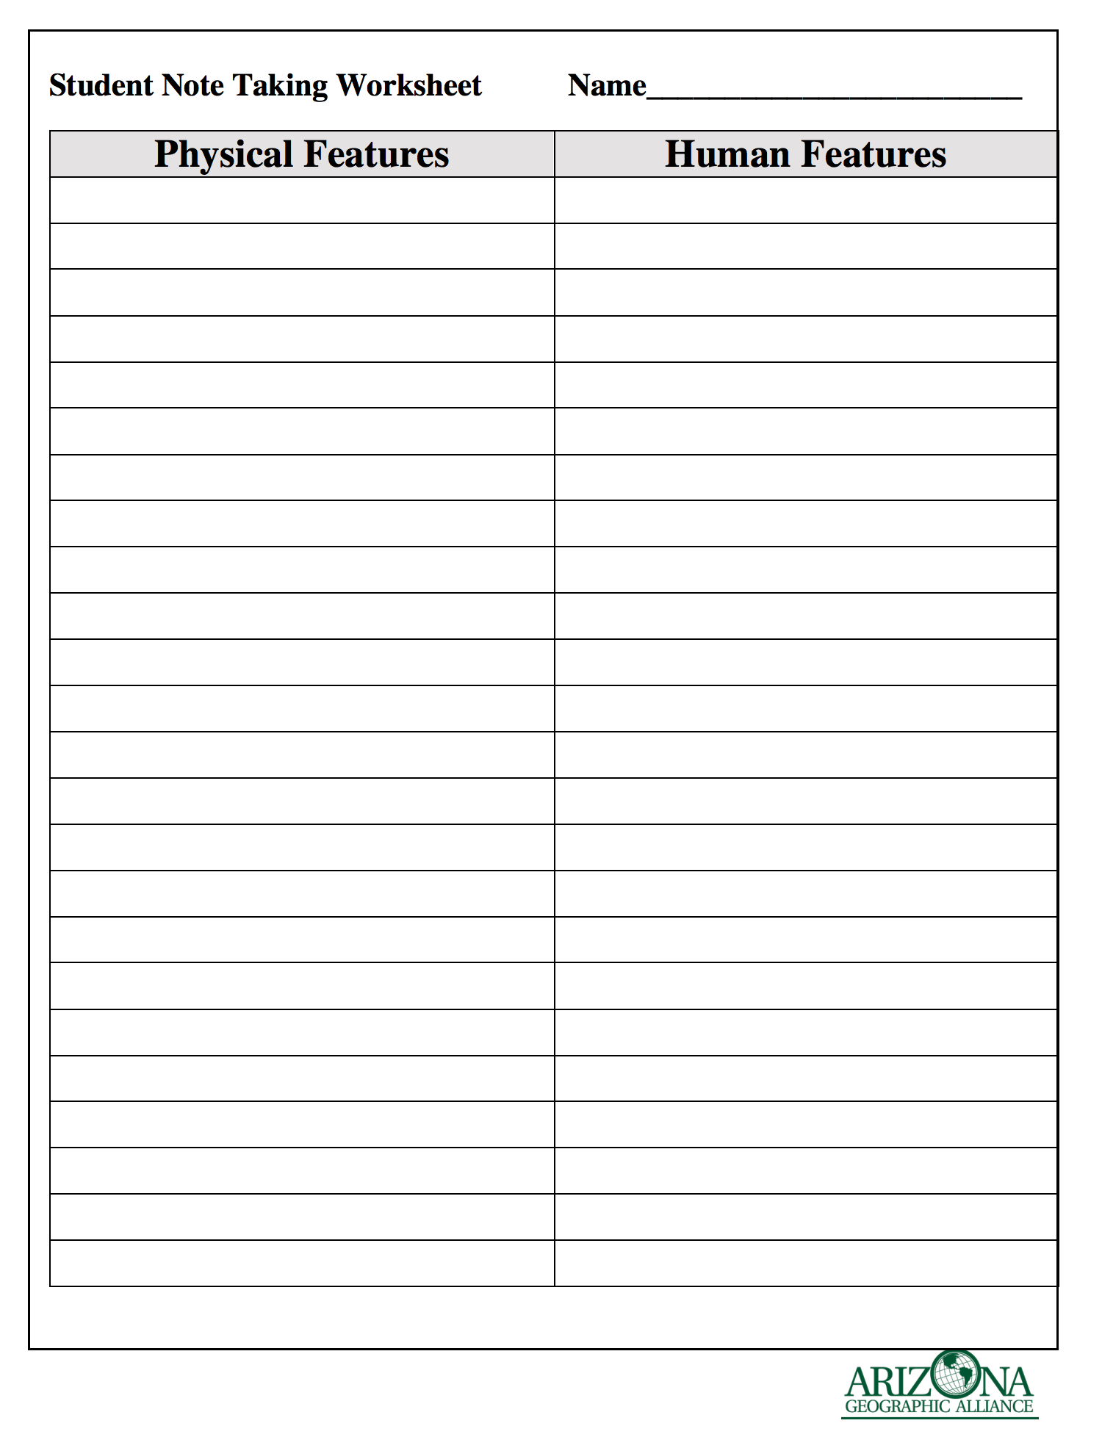
Arizona: way out west and witty
BY Gale Olp Ekiss
Now give students the directions to read through (individually, as a group, or as a small group) Arizona : Way Out West and Witty.
    As they enjoy the book and activities, they should be listing on the Student Note Taking Worksheet examples of human and physical features mentioned in the book.

Slide 51
Arizona: way out west and witty
BY Gale Olp Ekiss
    SESSION TWO to SESSION SEVEN
  Continue reading the book and completing the Student Note Taking Worksheet(s).
  At the end of Session Seven, have the students draw out of a “hat” one of the 25 cities listed on the Arizona Cities, with Latitude and Longitude Map as well as you can.
      Also add Sierra Vista, Glendale, Tempe, Florence, Cornville, Show Low, Tuba City, Chinle, Williams, Snowflake, Dewey, Bagdad, Surprise, Carefree, Apache Junction, Miami, Green Valley, Cave Creek, Wickenburg, Bisbee, Chandler, Holbrook, and Jerome that are mentioned in the book.
      Each child will focus on their selected community for Session Eight through Ten.

Slide 52



Arizona: way out west and witty
BY Gale Olp Ekiss
    SESSION EIGHT to TEN
Share the Scoring Guide for the Arizona Atlas and explain what each page should include. Then share the template (either paper, electronic, or power point version). And finally explain the Note Taking Worksheet for Internet Research.
If students are not done by SESSION TEN, homework may be required. If students finish early, they can create the cover, table of contents, and decide the order of the communities (alphabetical, north to south, largest communities to smallest). Then assemble the pages into your Arizona Atlas

Slide 53



Arizona: way out west and witty
BY Gale Olp Ekiss

Slide 54

Arizona: way out west and witty
BY Gale Olp Ekiss
Products will require students to:
describe communities in Arizona in terms of physical and human features.
gather and summarize research from various sources including the internet.
use correct conventions when writing.
identify human from physical features.

Slide 55
Arizona: way out west and witty
BY Gale Olp Ekiss
In the Chat Box, write whether you would use this lesson in your classroom.
Yes
No

Slide 56

AzGA’s Website https://geoalliance.asu.edu/

Slide 57



Standards Based Lesson Lists https://geoalliance.asu.edu/lessonlists

